Slide 1
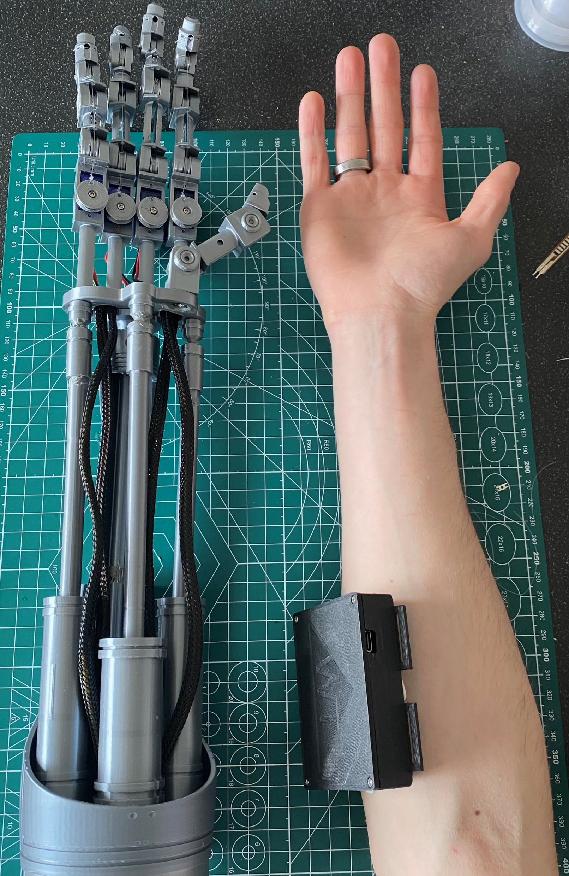
Technology & The Body
A non-invasive, Inexpensive Prosthetic Arm Prototype
Shane Whitmore 20098910

Slide 2
Preface
Visited City of Arts & Science in Valencia in 2023
Average cost for prosthetic = $40,000
Issue for young people

Slide 3

Goals
United Nations: Sustainable Development Goals
Use inexpensive, easy to source material
Use open source software
Outcome of project = an inexpensive, environmentally friendly prosthetic Prototype.
Notes:
End Poverty in All its Forms Everywhere
ensure healthy lives and promote well-being for all at all ages.

Slide 4
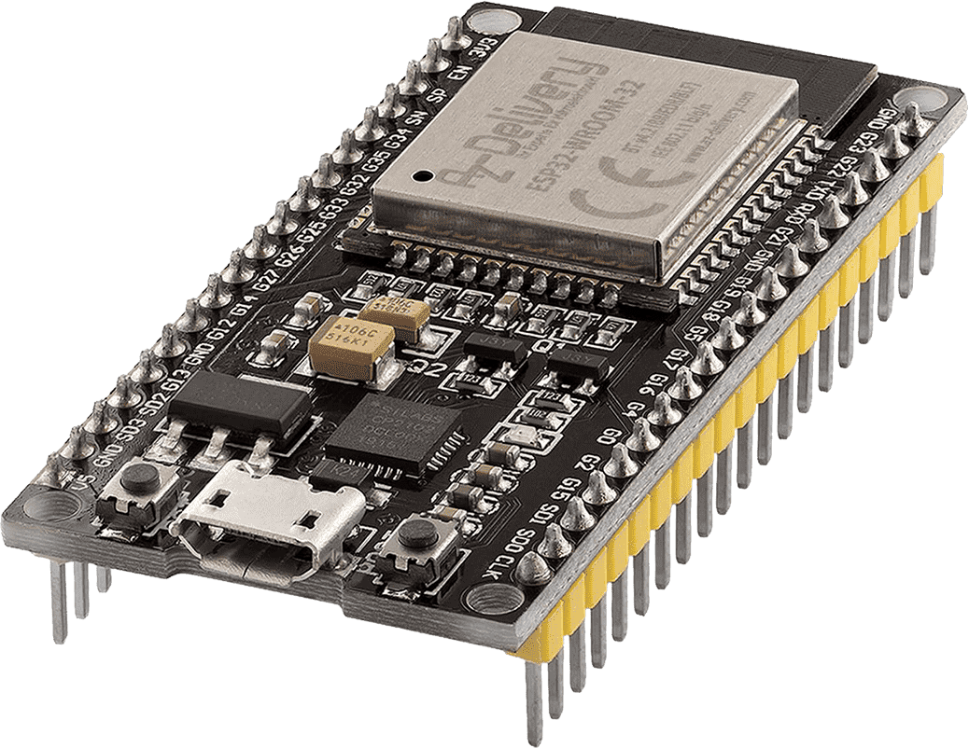
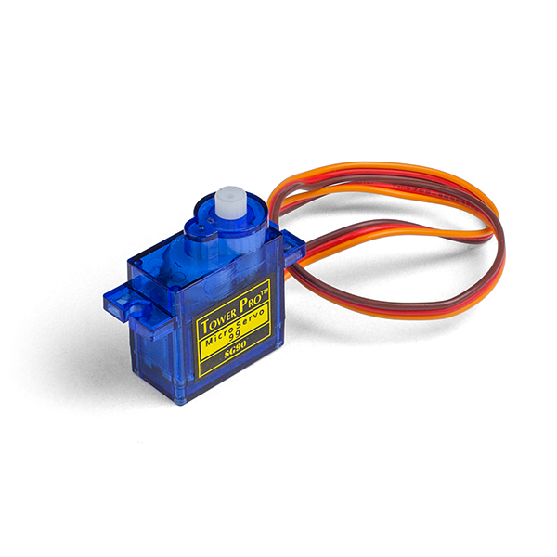
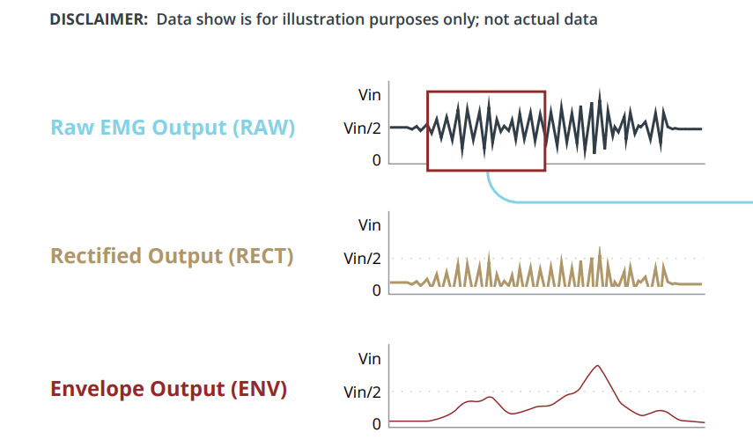
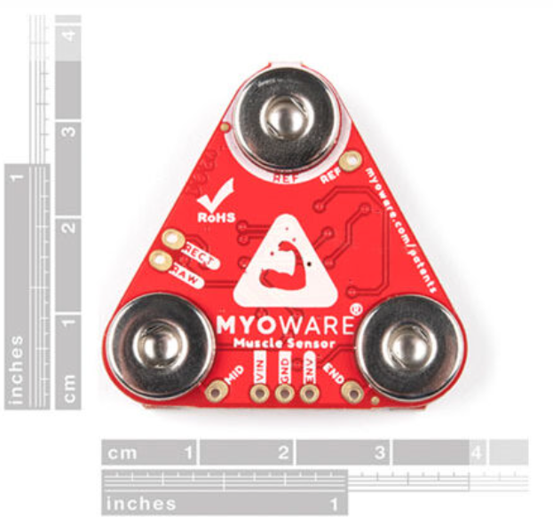
Hardware & Software
ESP-32 – Microcontroller Wireless Comms, PWM
Servos – continuous , low power
MyoWare 2.0 Sensor – surface Electromyography
Arduino IDE – environment for programming ESP-32
Fusion 360 – CAD software
Creality Slicer & Prusa Slicer

Slide 5
Methodology
Kanban – To-do, Doing, Done
Scrum – Weekly Meeting (Sprint)
GANNT – Project Timeline
Productivia – Task Managing App

Slide 6
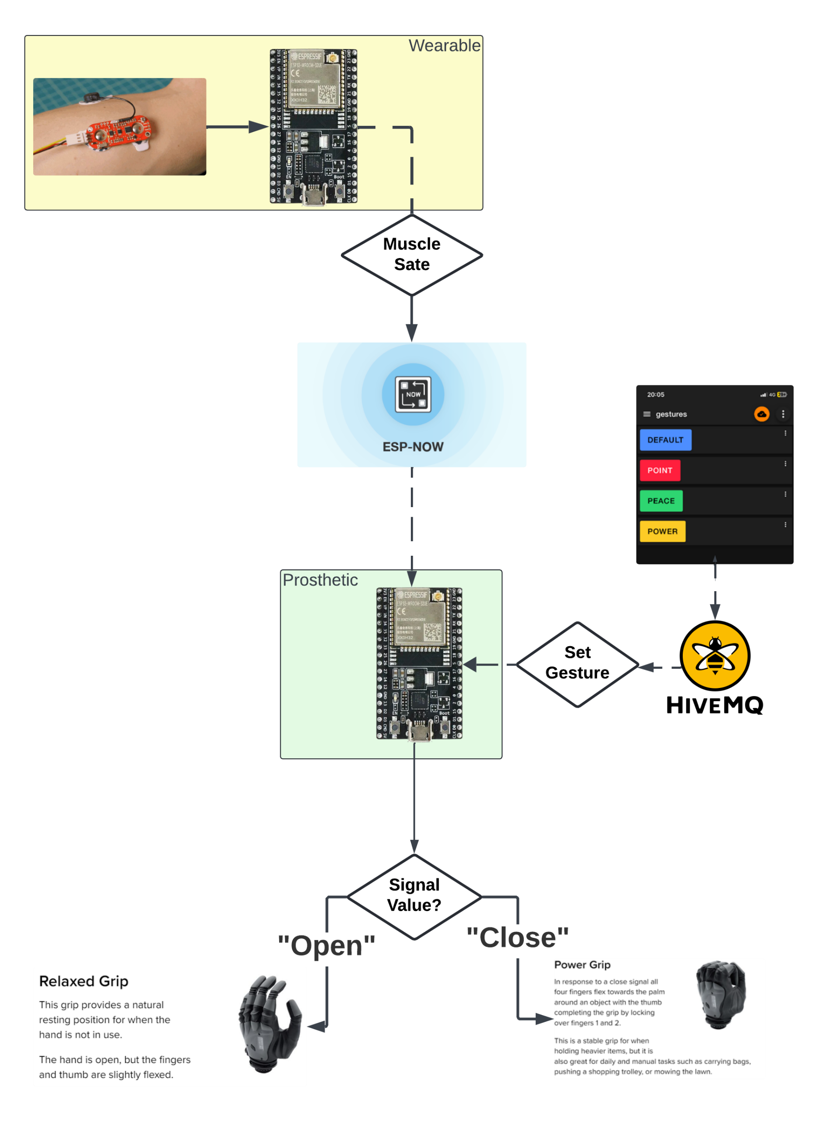
Flowchart

Slide 7
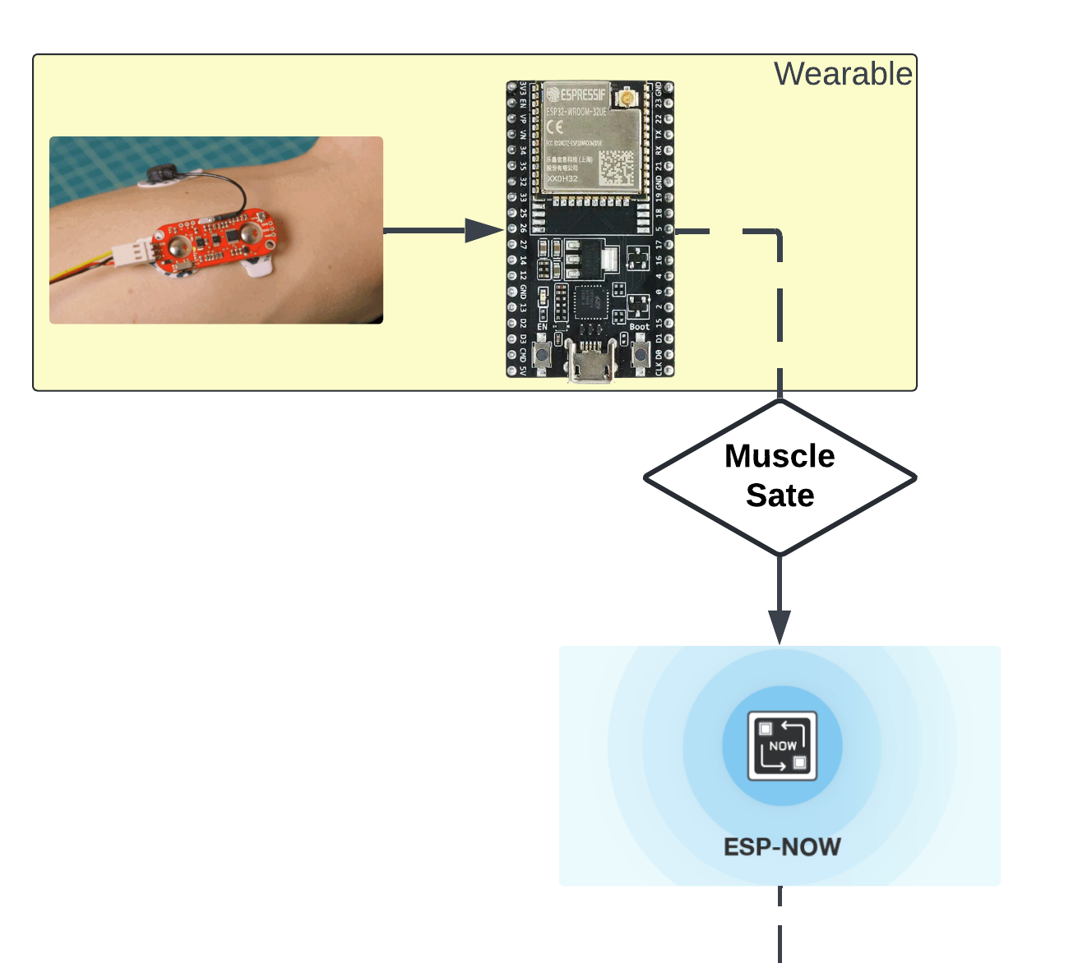
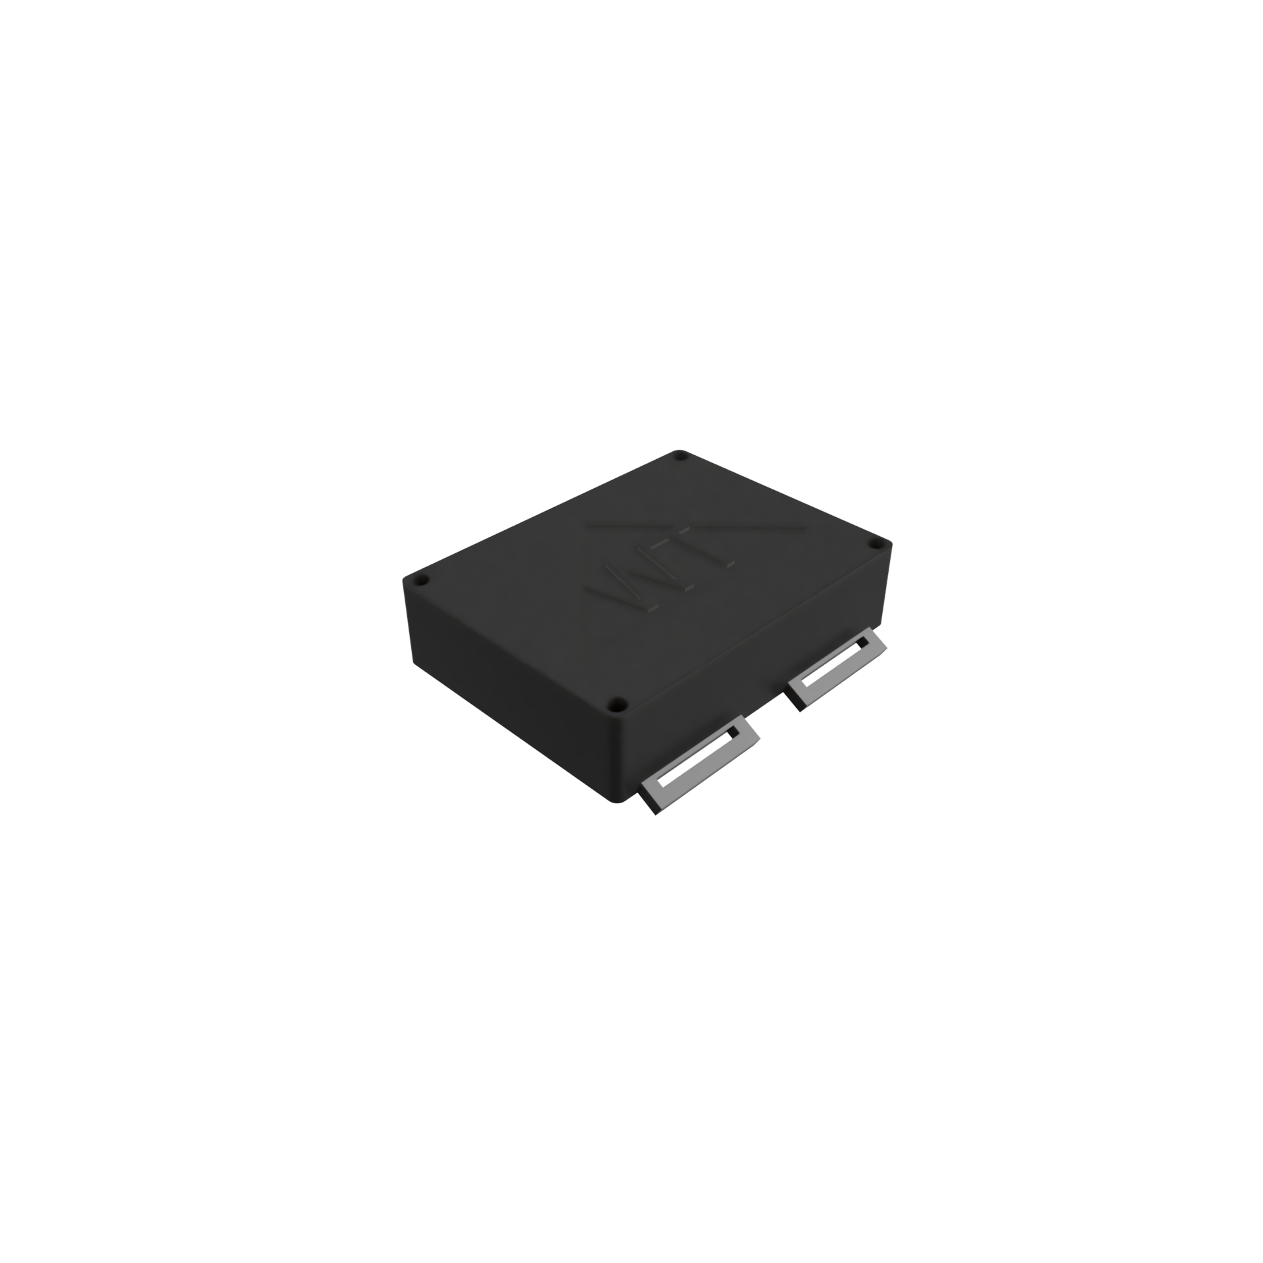
MyoWare 2.0 Sensor
Measures electric potential of muscles (muscle stimulation)
Using ESP32 to read Analog signal
Data is classified as True or False (see next slide for explanation)

Slide 8
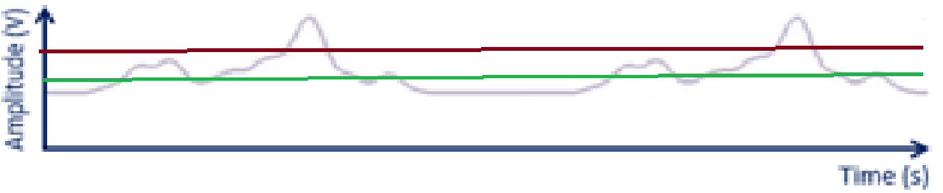
MyoWare 2.0 Sensor
Data above maxVal*0.55 classified as True
Data below maxval*0.25 classified as False

Slide 9
ESP-NOW
Wireless Communication Protocol (WCP)
Data is sent as a structured message with a binary variable
Unicast failed on campus due to high network interferences.
Broadcasting signal much more successful (One-way communication)

Slide 10
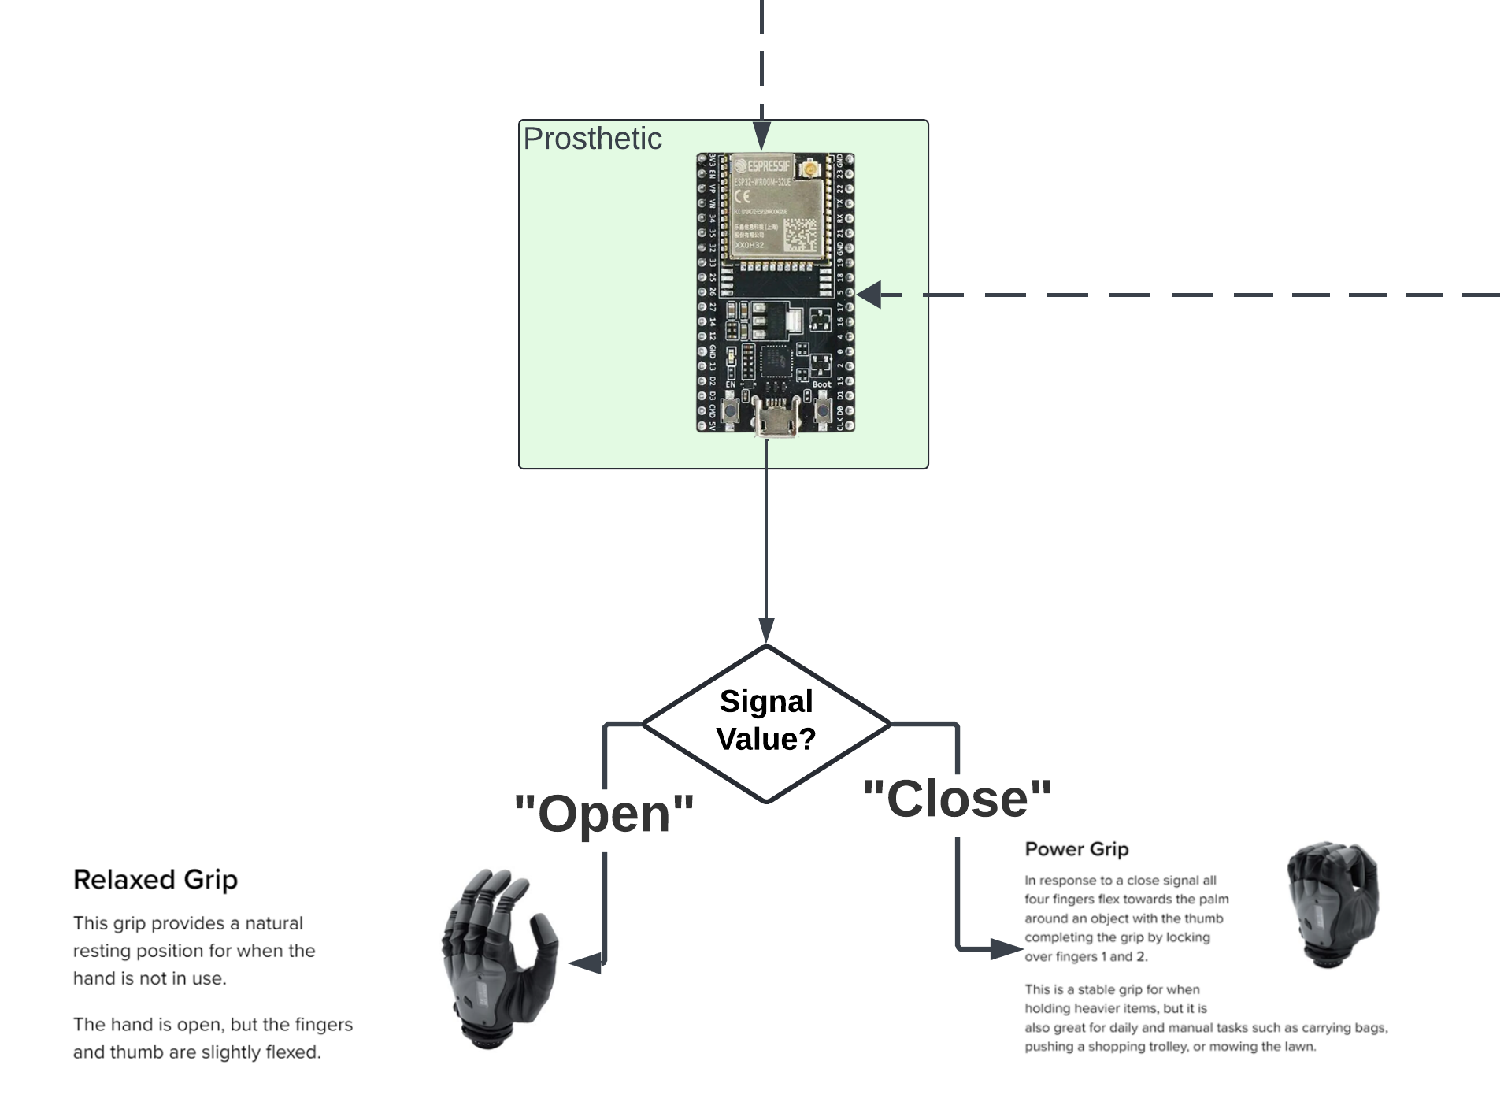
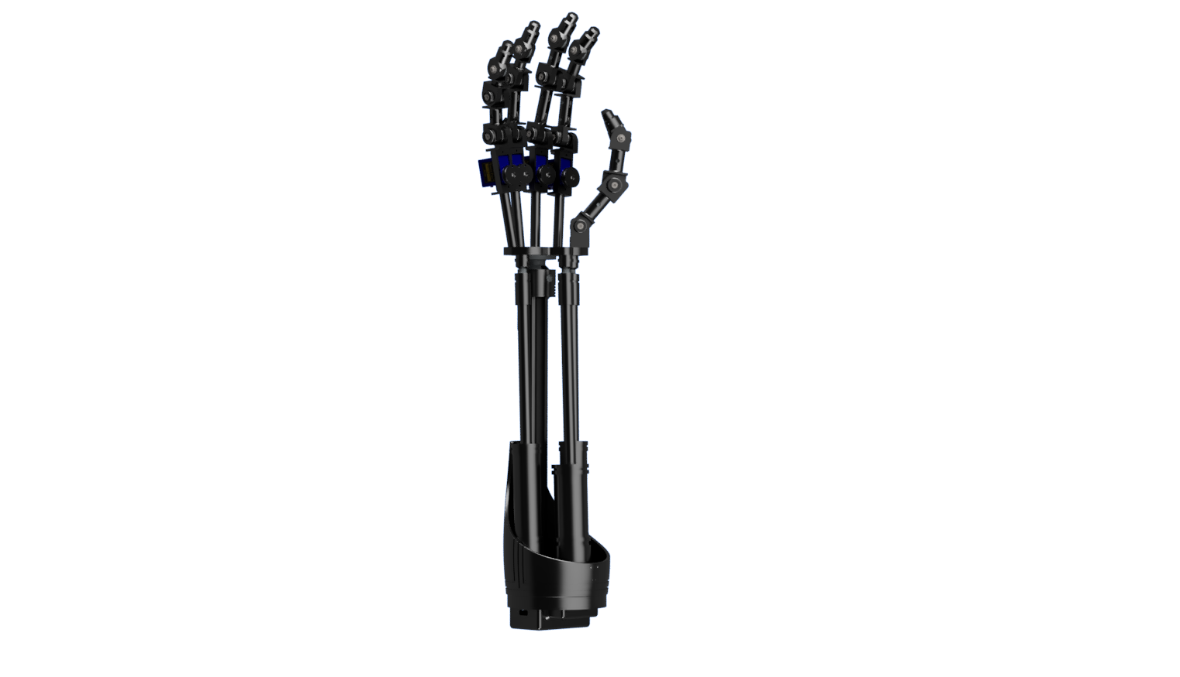
ESP-NOW
Data is received + copied to a structured message with a binary variable (prevents data type mismatch)
New value is checked against previous value before completing operation
If the new value is different from the previous value, open/close hand accordingly

Slide 11
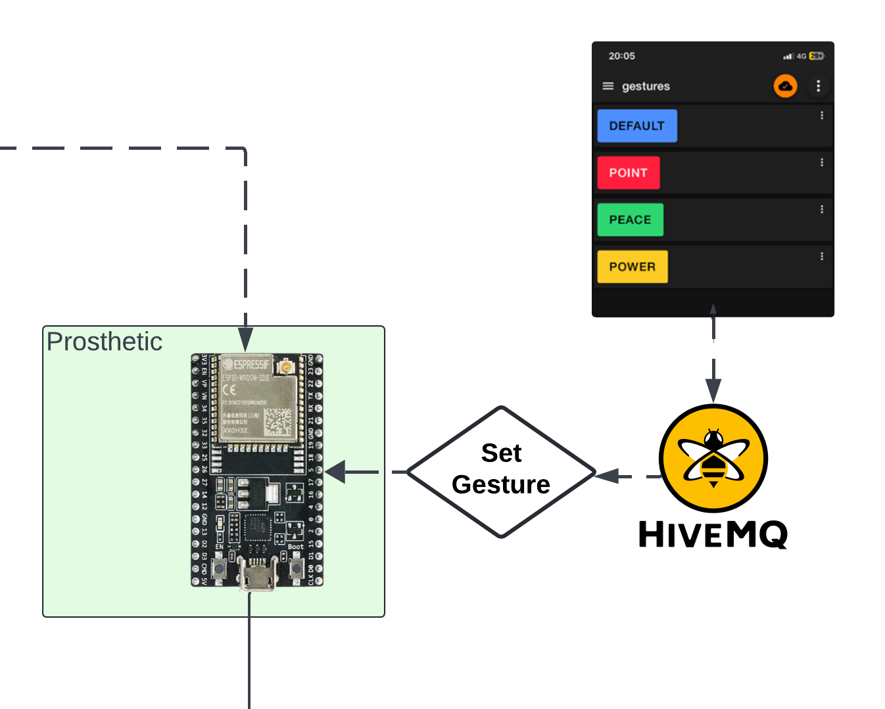
MQTT (Gesture Selection)
Designed for remote devices with limited resources
Used in this project to set gestures using a smart device
Data sent as {“value”:<payload>,”is public”:true}
Data unpacked by using a loop to return the characters of <payload> into a string

Slide 12
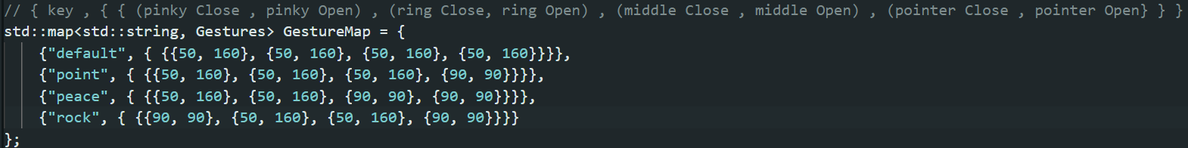
Gesture Map
Gesture mapped used for storing the rotation speed for each servo for each gesture.
Layout is <gesture> , <close,open> where rotation is stored in a 2D array

Slide 13

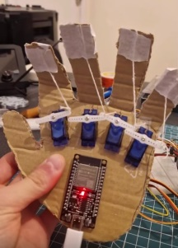
Timeline

Slide 14
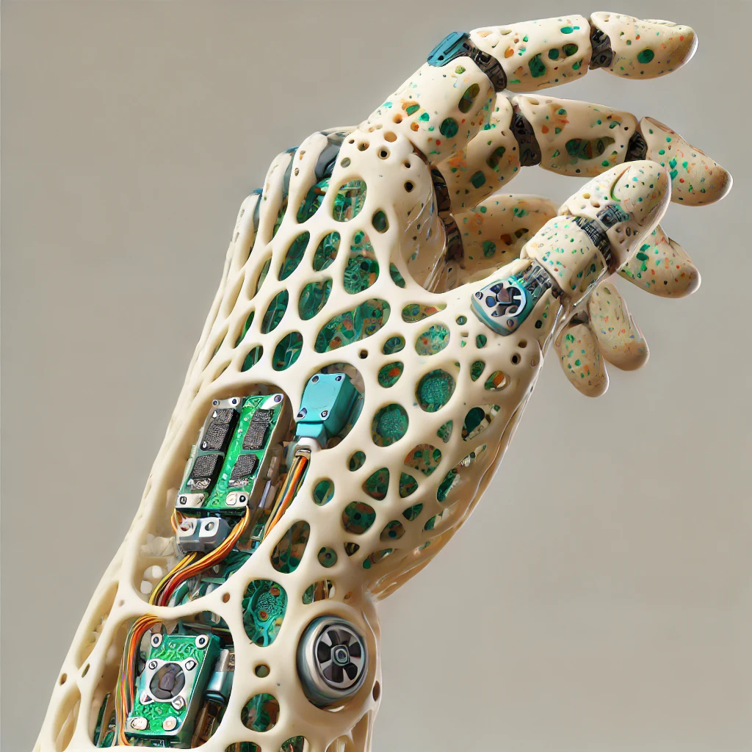
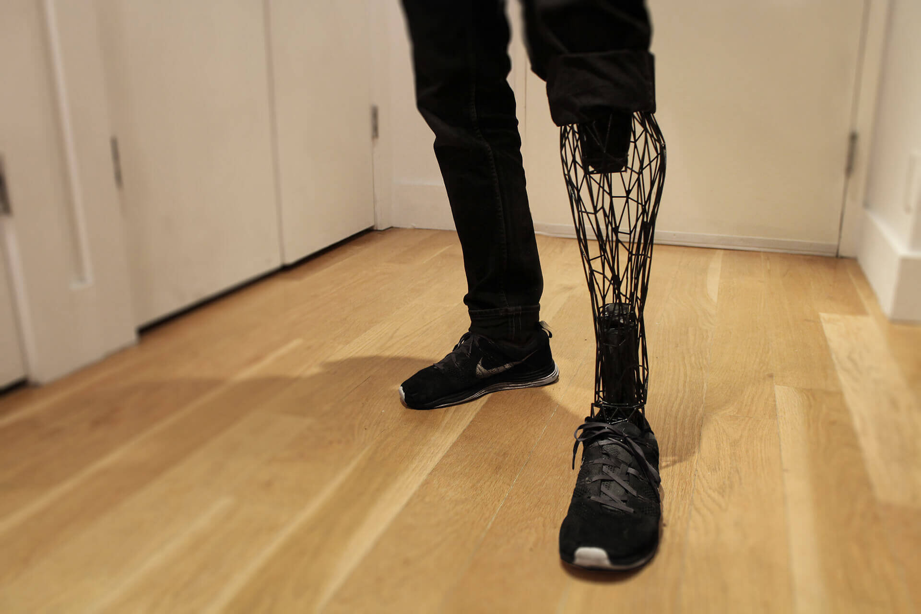
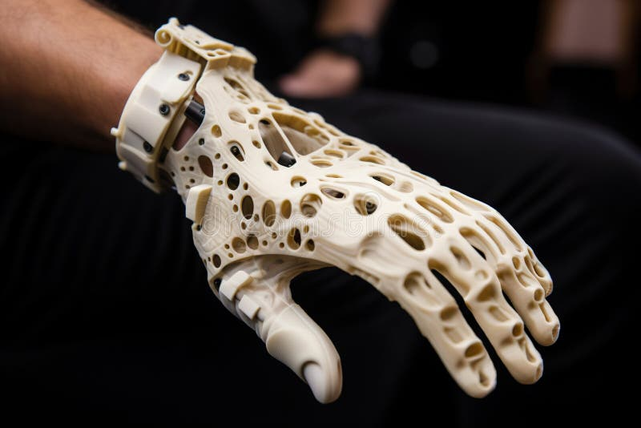
Future Iterations
*Image generated using ChatGPT

Slide 15
